Slide 1
Pokémon Go++
Iri Bandas
Sebastian Kurpiel
Ismail Ismail
Thanh phang
Daoud Shafique

Slide 2
Complexity
These days, games are all about graphics and how beautiful and vast they are.
However, a game doesn’t have to be super complex or visually appealing to still be fun
You can have just as much as fun with a little bit of effort and enjoy the fruit of your effort.

Slide 3
What we used and why?
What
Why
We decided to use the data structures commonly known as Linked List.
A singly linked list is an ordered set of data elements each containing a link to the next element.
Used a dynamically allocated array for the Pokedex
We thought this was the most versatile data structure
We didn’t use doubly linked lists because the intention was to make the levels progressive, not regressive.

Slide 4
Randomized
Random selection from the Pokémon pool.
No repeats
Random with every Run, so it wont be the same Pokémon each time.

Slide 5
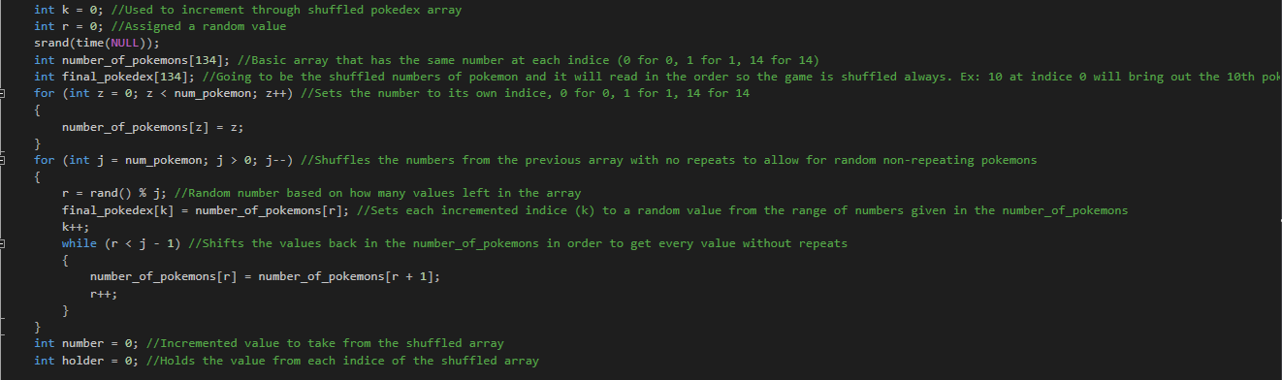

Slide 6
Level Structure- Pokémon
Up to 12 levels (1-3 is easy, 4-6 is medium, 7-9 is hard, 10-12 is legendary)
Progressively gets harder every 3 levels.
The further you progress, the less information is given to the players.
12th level is last level (the hardest level)
Now’s the time for you to truly prove your devotion to Pokémon

Slide 7
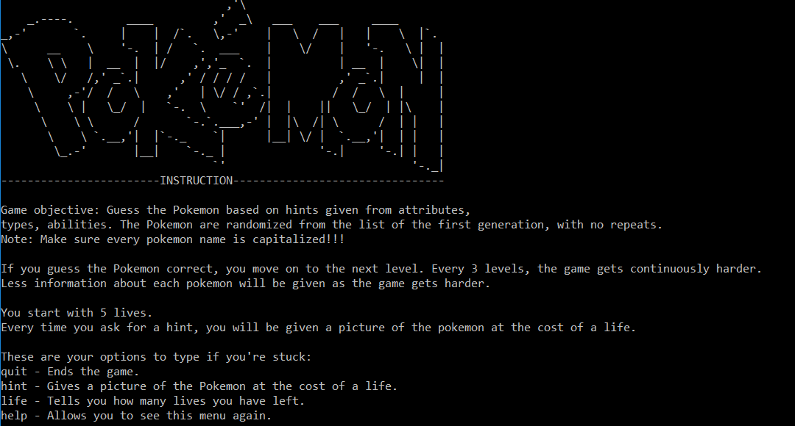

Slide 8
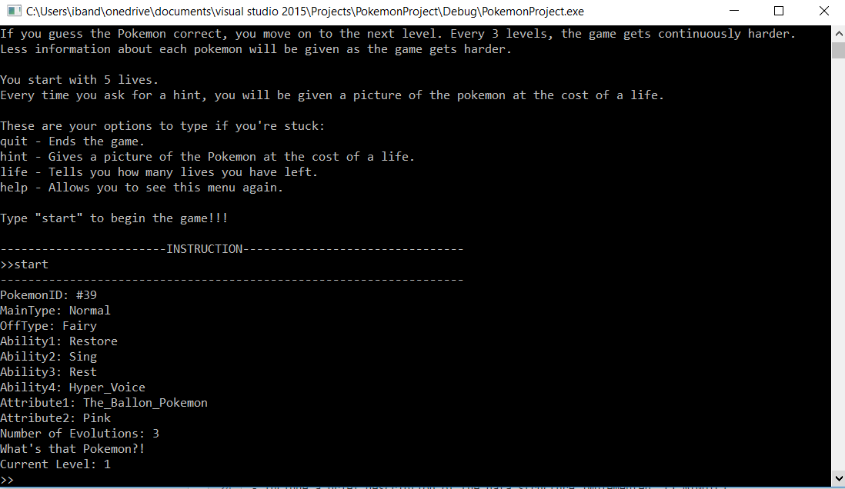

Slide 9
